Slide 1




Scalable Databases – Final Project Phase 1
CONTENTS
Extracting the data
Table creation and data loading
Data Analysis Tasks
Top 3 airports with highest delay time
Top 3 airlines with highest delay time
Largest type of delay
Conclusion
GROUP 3
SHIVAM
AMEY
SURAJ
RANJIT
THAO

Slide 2
Scalable Databases – Final Project Phase 1
CONTENTS
Extracting the data
Table creation and data loading
Data Analysis Tasks
Top 3 airports with highest delay time
Top 3 airlines with highest delay time
Largest type of delay
Conclusion
Data source
Data Expo 2009: Airline on time data The data represents flight arrival and departure details for all commercial flights within the USA for year 2003 Download link: Data Expo 2009: Airline on time data
GROUP 3
SHIVAM
AMEY
SURAJ
RANJIT
THAO

Slide 3
CONTENTS
Extracting the data
Table creation and data loading
Data Analysis Tasks
Top 3 airports with highest delay time
Top 3 airlines with highest delay time
Largest type of delay
Conclusion
Data source
Data Expo 2009: Airline on time data The data represents flight arrival and departure details for all commercial flights within the USA for all years Download link: Data Expo 2009: Airline on time data
Steps for Working with data in Hadoop
Step 1: Extracting the data from the site and download the csv file from the website.
Step 2: Creating a Hive table and load all the file data into it. Prefix the table name with your name.
Step 3: Displaying a first 100 rows.
Step 4: Data Analysis Tasks.

Slide 4
Data source
Data Expo 2009: Airline on time data The data represents flight arrival and departure details for all commercial flights within the USA for all years Download link: Data Expo 2009: Airline on time data
Steps for Working with data in Hadoop
Step 1: Extracting the data from the site and download the csv file from the website.
Step 2: Creating a Hive table and load all the file data into it. Prefix the table name with your name.
Step 3: Displaying a first 100 rows.
Step 4: Data Analysis Tasks.
Step 1: Extracting the data from the site and download the csv file from the website.
hdfs dfs -mkdir -p /user/hive/warehouse -creating “warehouse” directory inside “hive” directory
hdfs dfs -chmod g+w /user/hive/warehouse - granting write permission to the group
For 2003.csv File:
wget https://dataverse.harvard.edu/api/access/datafile/:persistentId?persistentId=doi:10.7910/DVN/HG7NV7/KM2QOA
mv :persistentId?persistentId=doi:10.7910%2FDVN%2FHG7NV7%2FKM2QOA 2003.csv.bz2
bzip2 -d 2003.csv.bz2 - unzip
hdfs dfs -put 2003.csv /user/hive/warehouse - Copying the new file back to HDFS

Slide 5
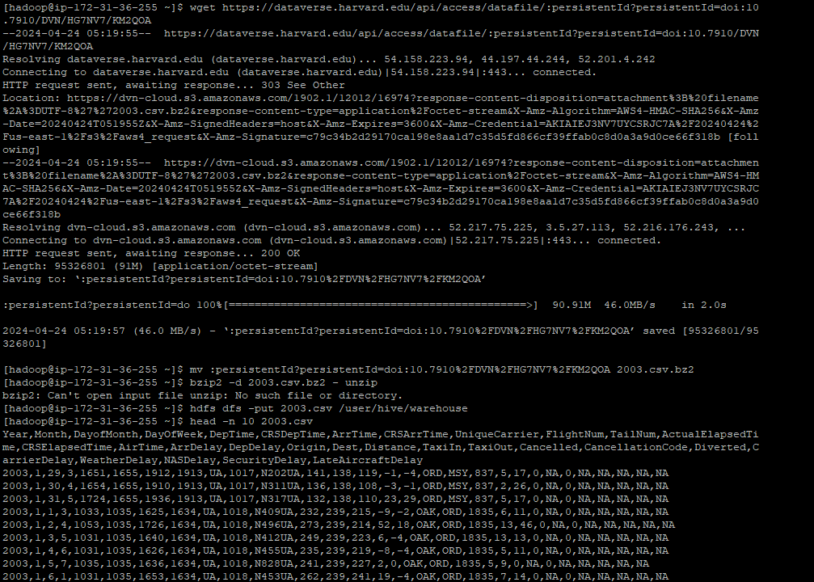
Step 1: Extracting the data from the site and download the csv file from the website.
hdfs dfs -mkdir -p /user/hive/warehouse -creating “warehouse” directory inside “hive” directory
hdfs dfs -chmod g+w /user/hive/warehouse - granting write permission to the group
For Example 2003.csv File:
wget https://dataverse.harvard.edu/api/access/datafile/:persistentId?persistentId=doi:10.7910/DVN/HG7NV7/KM2QOA
mv :persistentId?persistentId=doi:10.7910%2FDVN%2FHG7NV7%2FKM2QOA 2003.csv.bz2
bzip2 -d 2003.csv.bz2 - unzip
hdfs dfs -put 2003.csv /user/hive/warehouse - Copying the new file back to HDFS
Steps for Working with data in Hadoop
Step 1: Extracting the data from the site and download the csv file from the website.
Step 2: Creating a Hive table and load all the file data into it. Prefix the table name with your name.
Step 3: Displaying a first 100 rows.
Step 4: Data Analysis Tasks.
For Airports.csv
Wget https://dataverse.harvard.edu/api/access/datafile/:persistentId?persistentId=doi:10.7910/DVN/HG7NV7/XTPZZY
mv \:persistentId?persistentId=doi:10.7910%2FDVN%2FHG7NV7%2FXTPZZY Airports.csv
hdfs dfs -put Airports.csv /user/hive/warehouse - Copy the new file back to HDFS
head -n 10 Airports.csv -First 10 lines from csv file

Slide 6
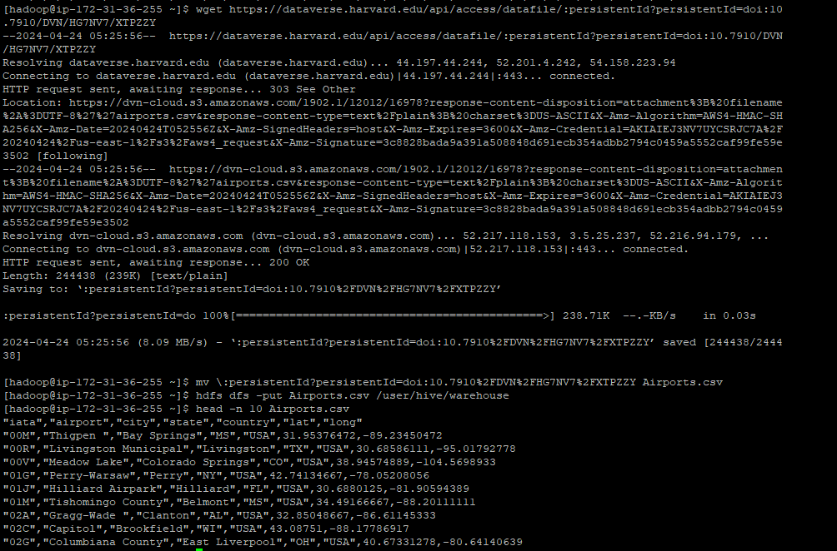
For Airports.csv
Wget https://dataverse.harvard.edu/api/access/datafile/:persistentId?persistentId=doi:10.7910/DVN/HG7NV7/XTPZZY
mv \:persistentId?persistentId=doi:10.7910%2FDVN%2FHG7NV7%2FXTPZZY Airports.csv
hdfs dfs -put Airports.csv /user/hive/warehouse - Copy the new file back to HDFS
head -n 10 Airports.csv -First 10 lines from csv file
For Carriers.csv File
wget https://dataverse.harvard.edu/api/access/datafile/:persistentId?persistentId=doi:10.7910/DVN/HG7NV7/3NOQ6Q
mv \:persistentId?persistentId=doi:10.7910%2FDVN%2FHG7NV7%2F3NOQ6Q Carriers.csv - renaming the downloaded file as Carriers.csv
hdfs dfs -put Carriers.csv /user/hive/warehouse - Copy the new file back to HDFS
head -n 10 Carriers.csv -First 10 lines from csv file
6. Creation of hive table and load all the data into it
Steps for Working with data in Hadoop
Step 1: Extracting the data from the site and download the csv file from the website.
Step 2: Creating a Hive table and load all the file data into it. Prefix the table name with your name.
Step 3: Displaying a first 100 rows.
Step 4: Data Analysis Tasks.

Slide 7
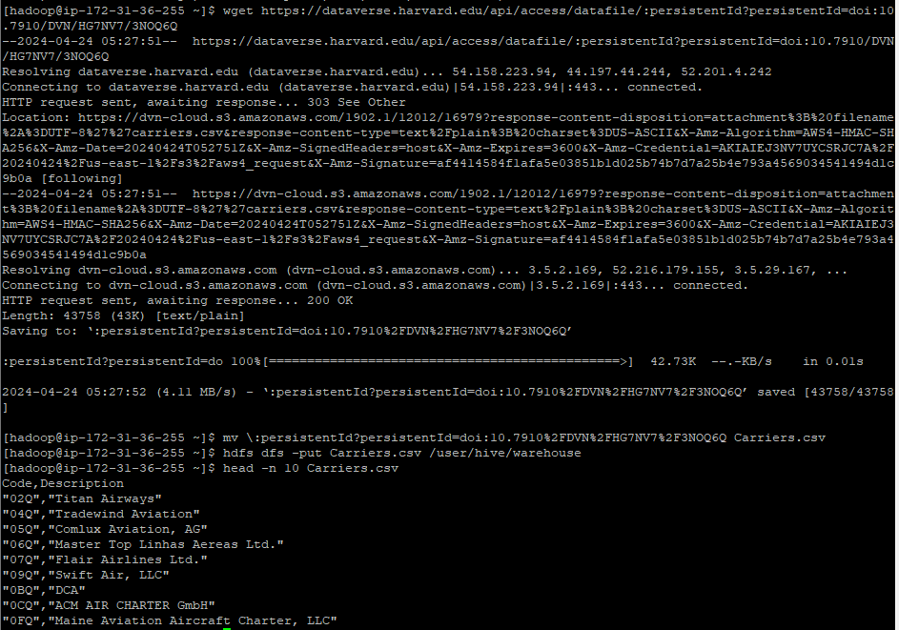
For Carriers.csv File
wget https://dataverse.harvard.edu/api/access/datafile/:persistentId?persistentId=doi:10.7910/DVN/HG7NV7/3NOQ6Q
mv \:persistentId?persistentId=doi:10.7910%2FDVN%2FHG7NV7%2F3NOQ6Q Carriers.csv - renaming the downloaded file as Carriers.csv
hdfs dfs -put Carriers.csv /user/hive/warehouse - Copy the new file back to HDFS
head -n 10 Carriers.csv -First 10 lines from csv file
For Airports.csv
Wget https://dataverse.harvard.edu/api/access/datafile/:persistentId?persistentId=doi:10.7910/DVN/HG7NV7/XTPZZY
mv \:persistentId?persistentId=doi:10.7910%2FDVN%2FHG7NV7%2FXTPZZY Airports.csv
hdfs dfs -put Airports.csv /user/hive/warehouse - Copy the new file back to HDFS
head -n 10 Airports.csv -First 10 lines from csv file

Slide 8
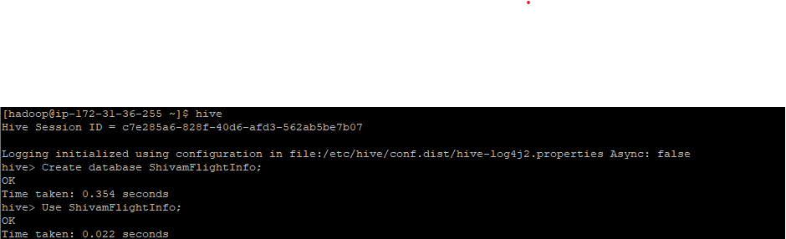
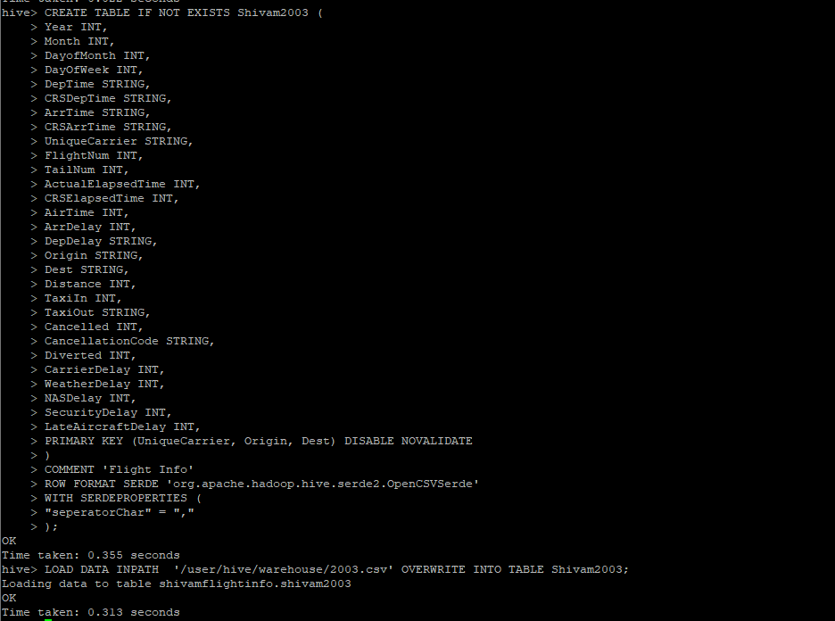
Step 2: Connect to Hive to Create Databases and Tables needed.
hive
Create database ShivamFlightInfo; -creating new database “AdityaFlightInfo”
Use ShivamFlightInfo; -Using the new database
Creating the table for datayear & load the data inpath
For Airports.csv
Wget https://dataverse.harvard.edu/api/access/datafile/:persistentId?persistentId=doi:10.7910/DVN/HG7NV7/XTPZZY
mv \:persistentId?persistentId=doi:10.7910%2FDVN%2FHG7NV7%2FXTPZZY Airports.csv
hdfs dfs -put Airports.csv /user/hive/warehouse - Copy the new file back to HDFS
head -n 10 Airports.csv -First 10 lines from csv file

Slide 9
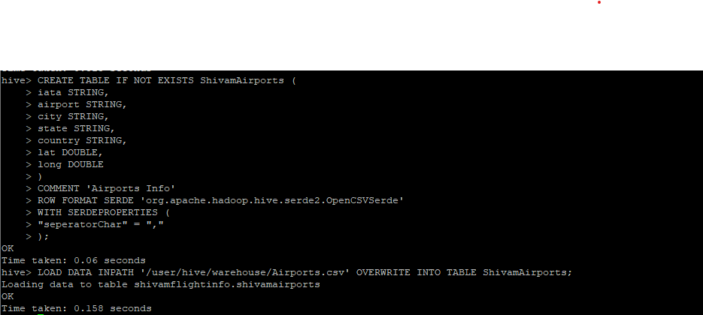
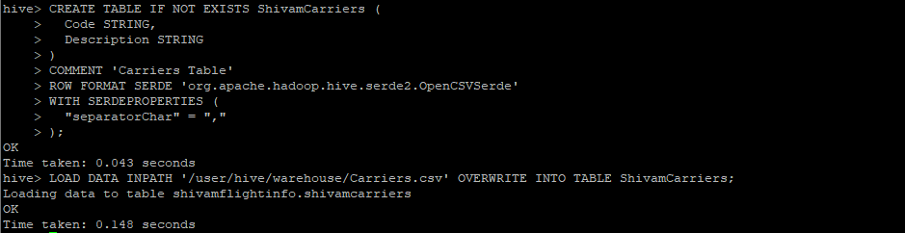
Step 2: Connect to Hive to Create Databases and Tables needed.
hive
Create database ShivamFlightInfo; -creating new database “ShivamFlightInfo”
Use ShivamFlightInfo; -Using the new database
Creating the necessary tables & loading the data inpath
For Airports.csv
Wget https://dataverse.harvard.edu/api/access/datafile/:persistentId?persistentId=doi:10.7910/DVN/HG7NV7/XTPZZY
mv \:persistentId?persistentId=doi:10.7910%2FDVN%2FHG7NV7%2FXTPZZY Airports.csv
hdfs dfs -put Airports.csv /user/hive/warehouse - Copy the new file back to HDFS
head -n 10 Airports.csv -First 10 lines from csv file

Slide 10
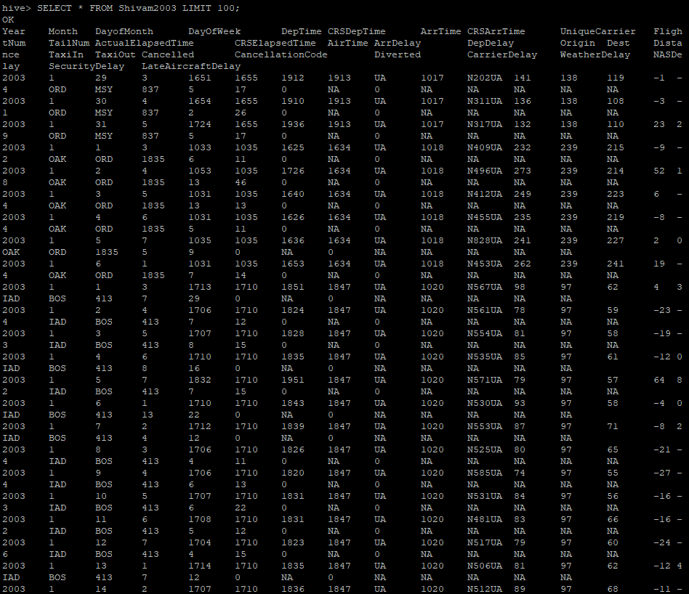
Step 3: Displaying 100 rows
SELECT * FROM Shivam2003 LIMIT 100;
For Airports.csv
Wget https://dataverse.harvard.edu/api/access/datafile/:persistentId?persistentId=doi:10.7910/DVN/HG7NV7/XTPZZY
mv \:persistentId?persistentId=doi:10.7910%2FDVN%2FHG7NV7%2FXTPZZY Airports.csv
hdfs dfs -put Airports.csv /user/hive/warehouse - Copy the new file back to HDFS
head -n 10 Airports.csv -First 10 lines from csv file

Slide 11
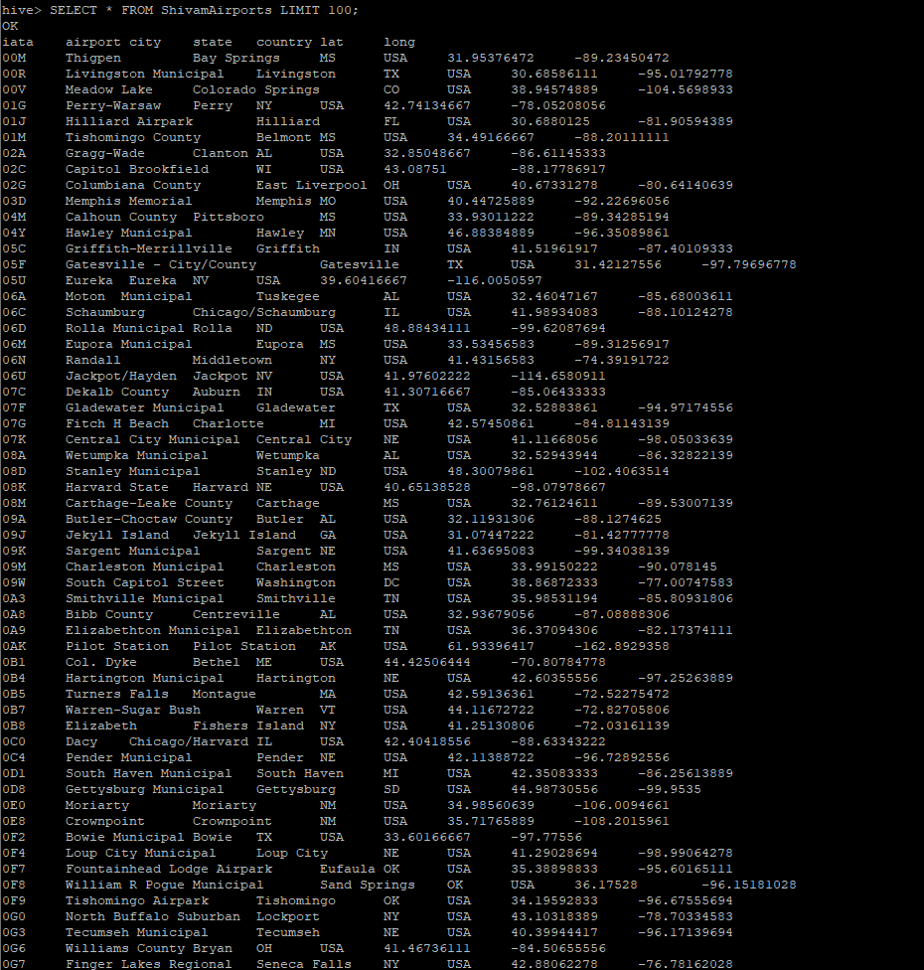
Step 3: Displaying 100 rows
SELECT * FROM Shivam2003 LIMIT 100;
Step 3: Displaying 100 rows
SELECT * FROM ShivamAirports LIMIT 100;
For Airports.csv
Wget https://dataverse.harvard.edu/api/access/datafile/:persistentId?persistentId=doi:10.7910/DVN/HG7NV7/XTPZZY
mv \:persistentId?persistentId=doi:10.7910%2FDVN%2FHG7NV7%2FXTPZZY Airports.csv
hdfs dfs -put Airports.csv /user/hive/warehouse - Copy the new file back to HDFS
head -n 10 Airports.csv -First 10 lines from csv file

Slide 12
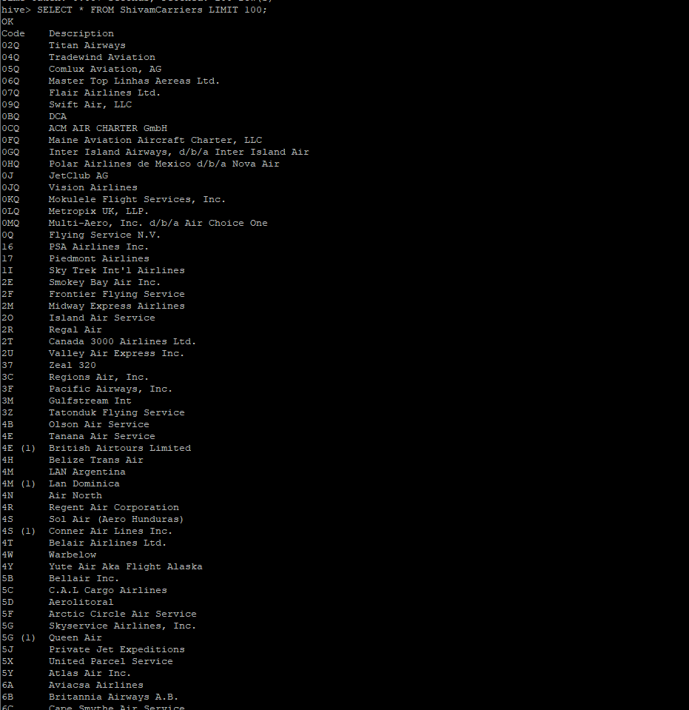
Step 3: Displaying 100 rows
SELECT * FROM ShivamAirports LIMIT 100;
Step 3: Displaying 100 rows
SELECT * FROM ShivamCarriers LIMIT 100;
For Airports.csv
Wget https://dataverse.harvard.edu/api/access/datafile/:persistentId?persistentId=doi:10.7910/DVN/HG7NV7/XTPZZY
mv \:persistentId?persistentId=doi:10.7910%2FDVN%2FHG7NV7%2FXTPZZY Airports.csv
hdfs dfs -put Airports.csv /user/hive/warehouse - Copy the new file back to HDFS
head -n 10 Airports.csv -First 10 lines from csv file

Slide 13
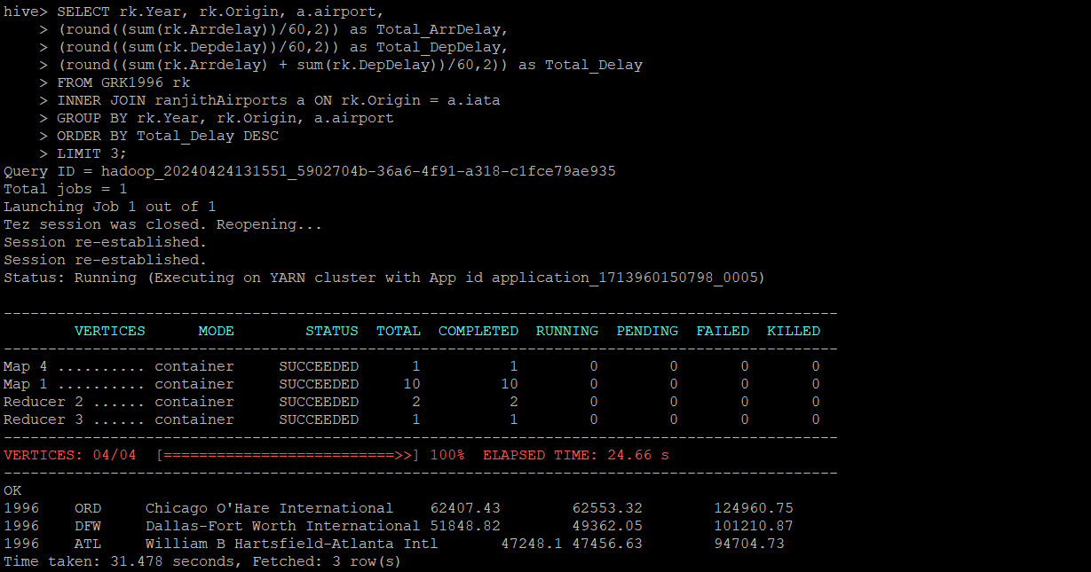
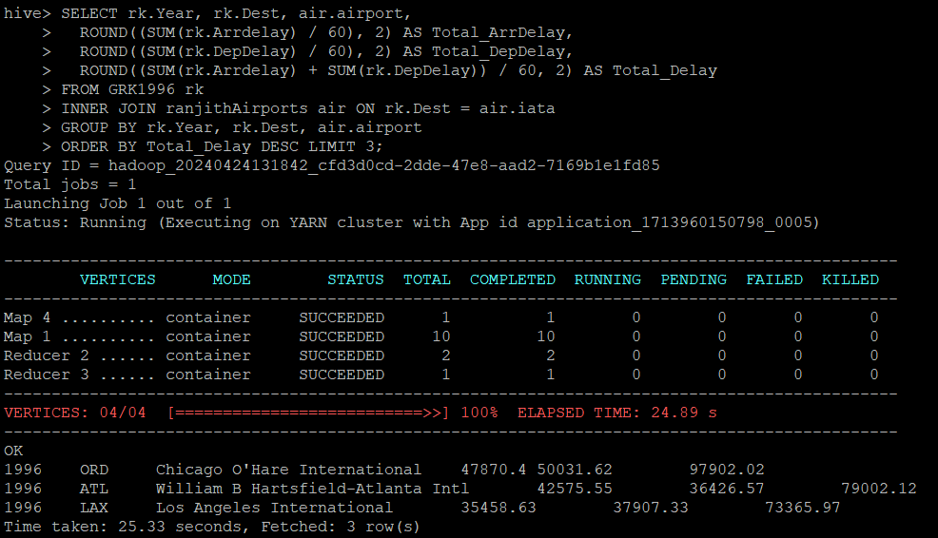
Step 3: Displaying 100 rows
SELECT * FROM ShivamCarriers LIMIT 100;
Step 4: Data Analysis
Determine the three airports with the highest delay time (in hours)
Year 1996
Origin
Dest
For Airports.csv
Wget https://dataverse.harvard.edu/api/access/datafile/:persistentId?persistentId=doi:10.7910/DVN/HG7NV7/XTPZZY
mv \:persistentId?persistentId=doi:10.7910%2FDVN%2FHG7NV7%2FXTPZZY Airports.csv
hdfs dfs -put Airports.csv /user/hive/warehouse - Copy the new file back to HDFS
head -n 10 Airports.csv -First 10 lines from csv file

Slide 14
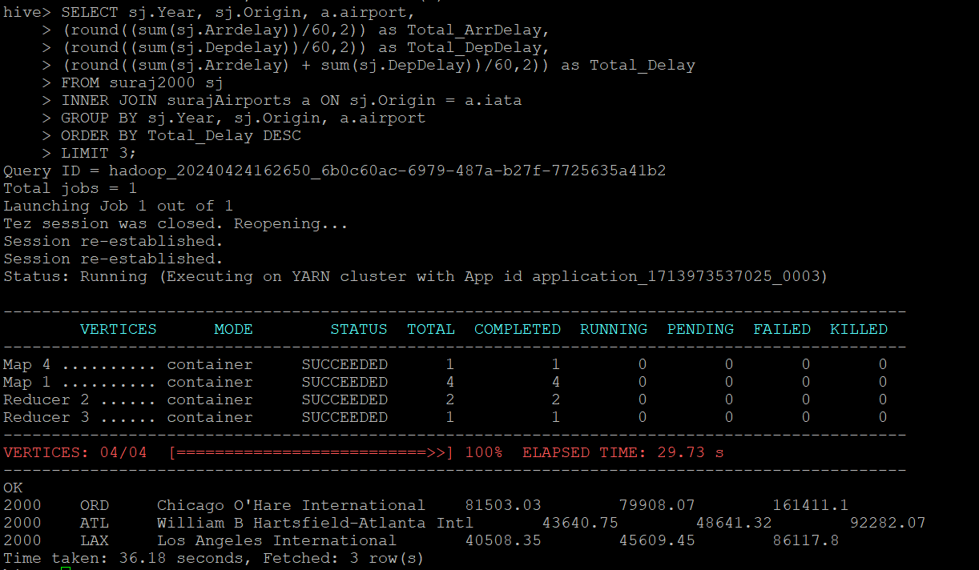
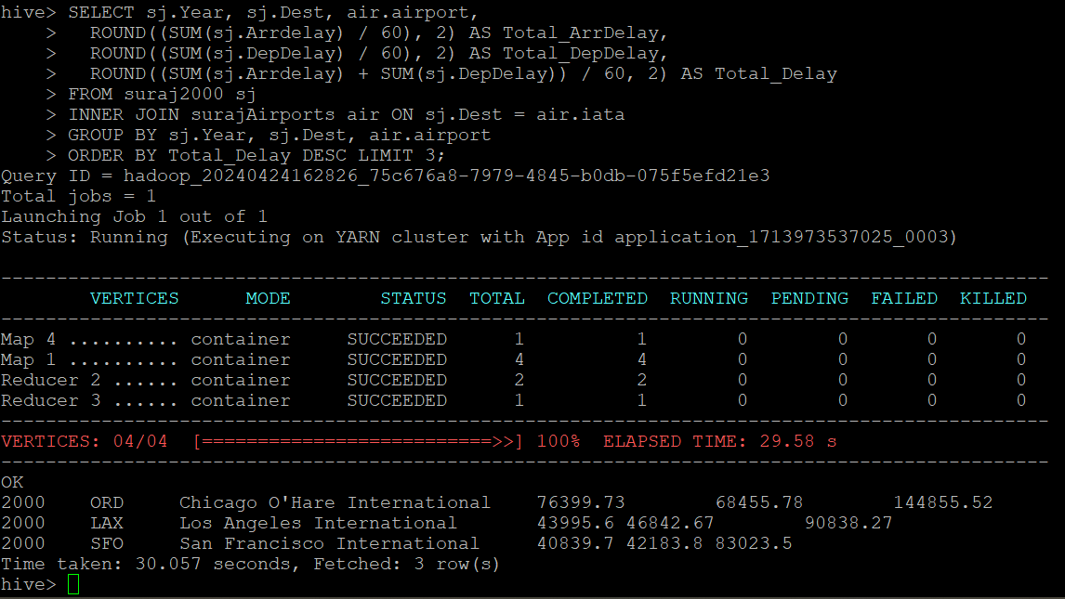
Step 4: Data Analysis
Determine the three airports with the highest delay time (in hours)
Year 1996
Origin
Dest
Step 4: Data Analysis
Determine the three airports with the highest delay time (in hours)
Year 2000
Origin
Dest
For Airports.csv
Wget https://dataverse.harvard.edu/api/access/datafile/:persistentId?persistentId=doi:10.7910/DVN/HG7NV7/XTPZZY
mv \:persistentId?persistentId=doi:10.7910%2FDVN%2FHG7NV7%2FXTPZZY Airports.csv
hdfs dfs -put Airports.csv /user/hive/warehouse - Copy the new file back to HDFS
head -n 10 Airports.csv -First 10 lines from csv file

Slide 15
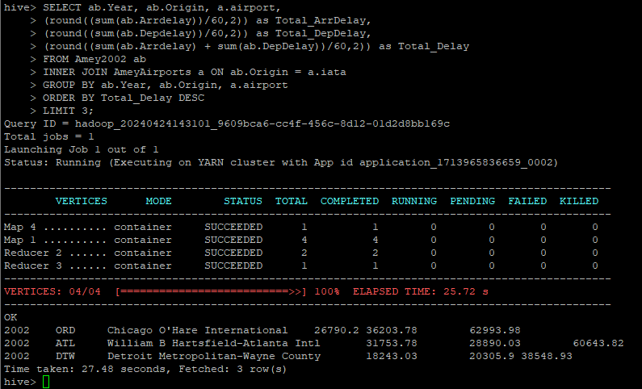
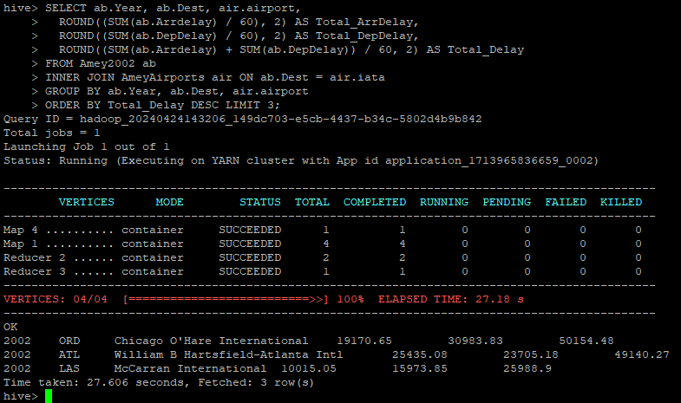
Step 4: Data Analysis
Determine the three airports with the highest delay time (in hours)
Year 2000
Origin
Dest
Step 4: Data Analysis
Determine the three airports with the highest delay time (in hours)
Year 2002
Origin
Dest
Step 4: Data Analysis
Determine the three airports with the highest delay time (in hours)
Year 2002
Origin
Dest
For Airports.csv
Wget https://dataverse.harvard.edu/api/access/datafile/:persistentId?persistentId=doi:10.7910/DVN/HG7NV7/XTPZZY
mv \:persistentId?persistentId=doi:10.7910%2FDVN%2FHG7NV7%2FXTPZZY Airports.csv
hdfs dfs -put Airports.csv /user/hive/warehouse - Copy the new file back to HDFS
head -n 10 Airports.csv -First 10 lines from csv file

Slide 16
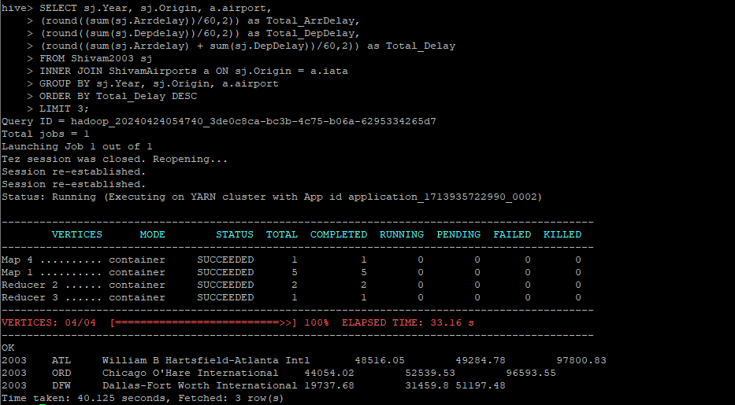
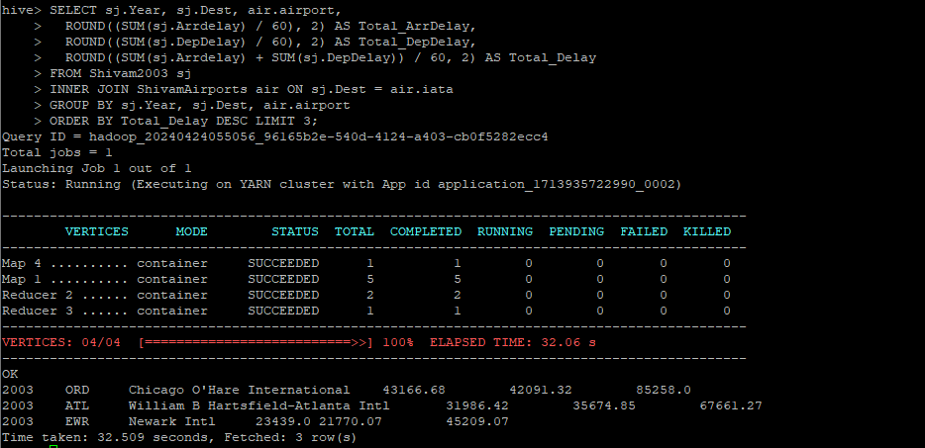
Step 4: Data Analysis
Determine the three airports with the highest delay time (in hours)
Year 2002
Origin
Dest
Step 4: Data Analysis
Determine the three airports with the highest delay time (in hours)
Year 2002
Origin
Dest
Step 4: Data Analysis
Determine the three airports with the highest delay time (in hours)
Year 2003
Origin
Dest
For Airports.csv
Wget https://dataverse.harvard.edu/api/access/datafile/:persistentId?persistentId=doi:10.7910/DVN/HG7NV7/XTPZZY
mv \:persistentId?persistentId=doi:10.7910%2FDVN%2FHG7NV7%2FXTPZZY Airports.csv
hdfs dfs -put Airports.csv /user/hive/warehouse - Copy the new file back to HDFS
head -n 10 Airports.csv -First 10 lines from csv file

Slide 17
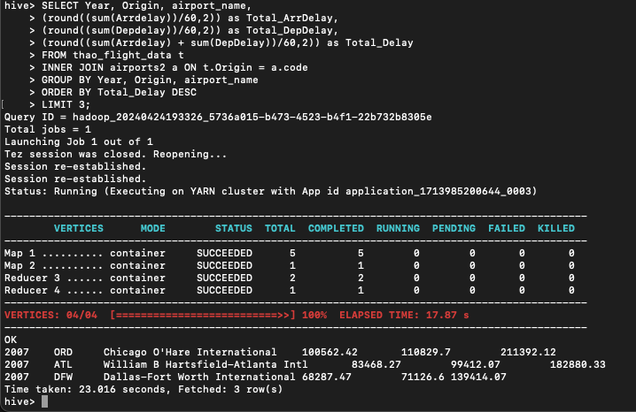
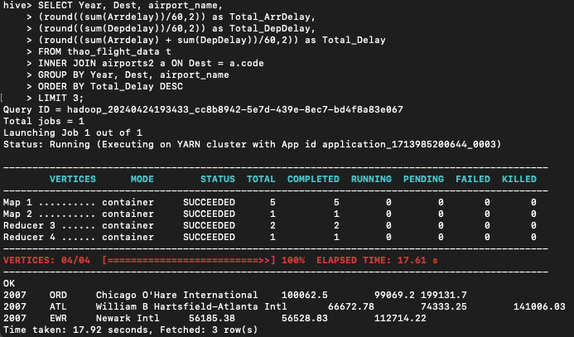
Step 4: Data Analysis
Determine the three airports with the highest delay time (in hours)
Year 2003
Origin
Dest
Step 4: Data Analysis
Determine the three airports with the highest delay time (in hours)
Year 2007
Origin
Dest
For Airports.csv
Wget https://dataverse.harvard.edu/api/access/datafile/:persistentId?persistentId=doi:10.7910/DVN/HG7NV7/XTPZZY
mv \:persistentId?persistentId=doi:10.7910%2FDVN%2FHG7NV7%2FXTPZZY Airports.csv
hdfs dfs -put Airports.csv /user/hive/warehouse - Copy the new file back to HDFS
head -n 10 Airports.csv -First 10 lines from csv file

Slide 18
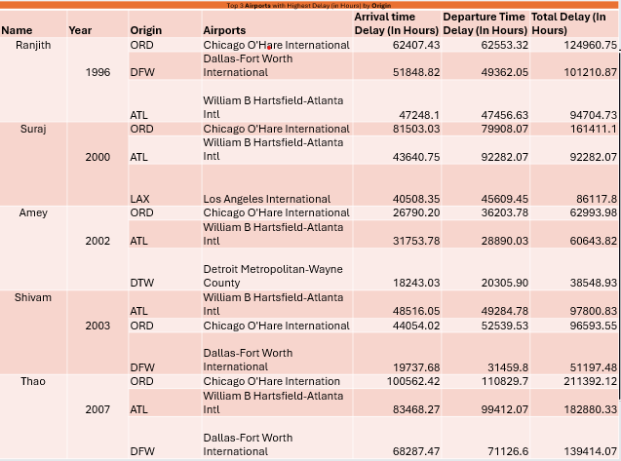
Step 4: Data Analysis
Determine the three airports with the highest delay time (in hours)
Year 2007
Origin
Dest
Step 4: Data Analysis
Determine the three airports with the highest delay time (in hours)
Table with results of all the Years together
Origin
For Airports.csv
Wget https://dataverse.harvard.edu/api/access/datafile/:persistentId?persistentId=doi:10.7910/DVN/HG7NV7/XTPZZY
mv \:persistentId?persistentId=doi:10.7910%2FDVN%2FHG7NV7%2FXTPZZY Airports.csv
hdfs dfs -put Airports.csv /user/hive/warehouse - Copy the new file back to HDFS
head -n 10 Airports.csv -First 10 lines from csv file

Slide 19
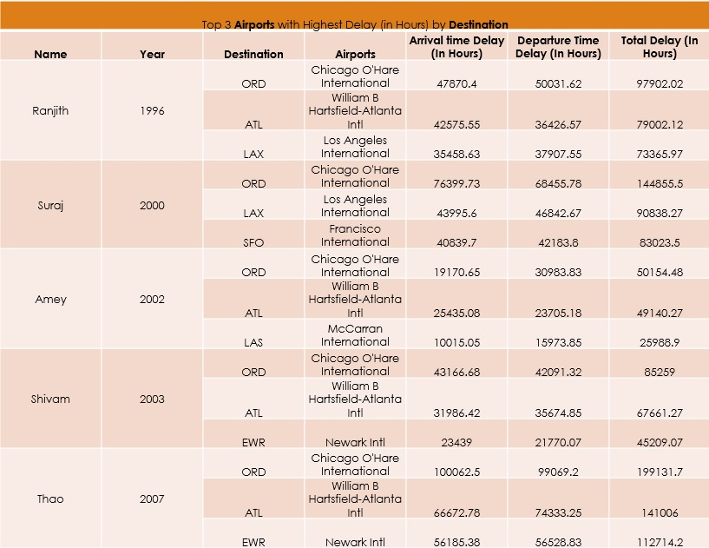
Step 4: Data Analysis
Determine the three airports with the highest delay time (in hours)
Table with results of all the Years together
Origin
Step 4: Data Analysis
Determine the three airports with the highest delay time (in hours)
Table with results of all the Years together
Destination
For Airports.csv
Wget https://dataverse.harvard.edu/api/access/datafile/:persistentId?persistentId=doi:10.7910/DVN/HG7NV7/XTPZZY
mv \:persistentId?persistentId=doi:10.7910%2FDVN%2FHG7NV7%2FXTPZZY Airports.csv
hdfs dfs -put Airports.csv /user/hive/warehouse - Copy the new file back to HDFS
head -n 10 Airports.csv -First 10 lines from csv file

Slide 20
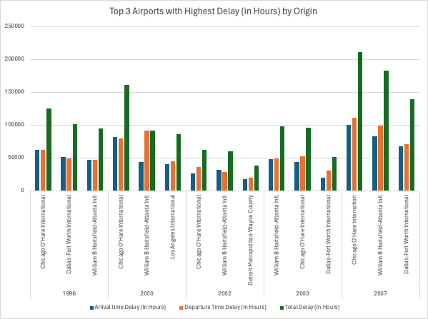
Step 4: Data Analysis
Determine the three airports with the highest delay time (in hours)
Table with results of all the Years together
Destination
Step 4: Data Analysis
Determine the three airports with the highest delay time (in hours)
Visulazation
Origin
For Airports.csv
Wget https://dataverse.harvard.edu/api/access/datafile/:persistentId?persistentId=doi:10.7910/DVN/HG7NV7/XTPZZY
mv \:persistentId?persistentId=doi:10.7910%2FDVN%2FHG7NV7%2FXTPZZY Airports.csv
hdfs dfs -put Airports.csv /user/hive/warehouse - Copy the new file back to HDFS
head -n 10 Airports.csv -First 10 lines from csv file

Slide 21
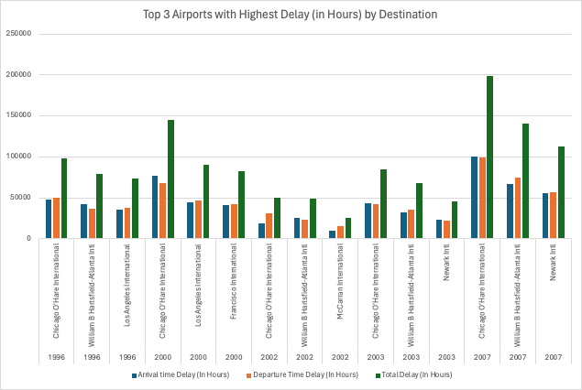
Step 4: Data Analysis
Determine the three airports with the highest delay time (in hours)
Visulazation
Origin
Step 4: Data Analysis
Determine the three airports with the highest delay time (in hours)
Visulazation
Destination
For Airports.csv
Wget https://dataverse.harvard.edu/api/access/datafile/:persistentId?persistentId=doi:10.7910/DVN/HG7NV7/XTPZZY
mv \:persistentId?persistentId=doi:10.7910%2FDVN%2FHG7NV7%2FXTPZZY Airports.csv
hdfs dfs -put Airports.csv /user/hive/warehouse - Copy the new file back to HDFS
head -n 10 Airports.csv -First 10 lines from csv file

Slide 22
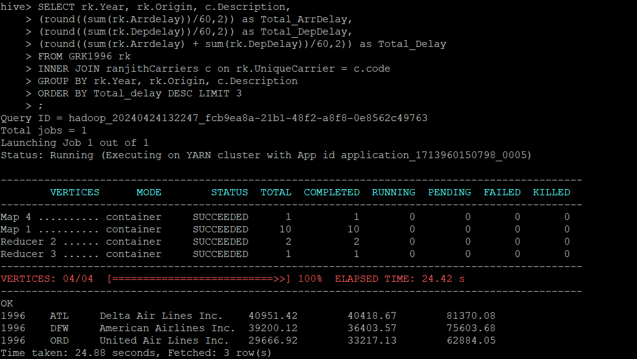
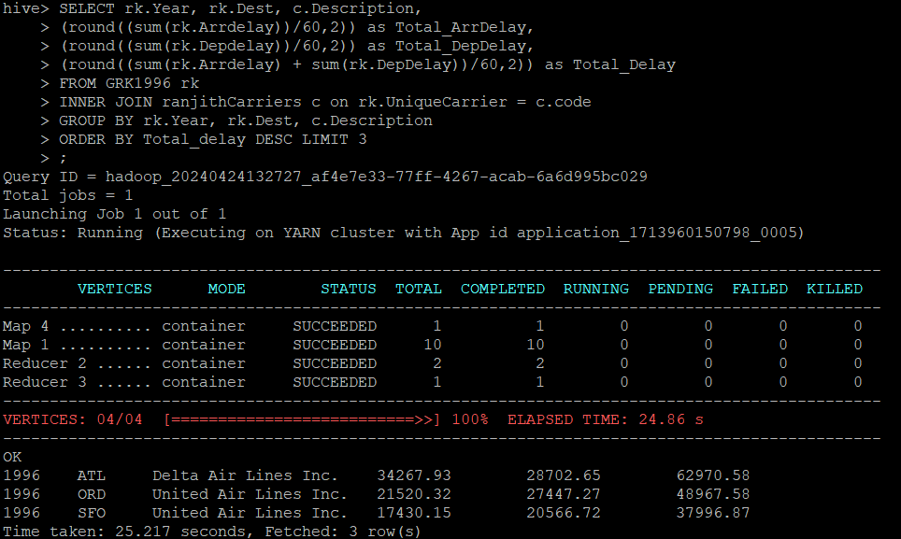
Step 4: Data Analysis
Determine the three airports with the highest delay time (in hours)
Visulazation
Destination
Step 4: Data Analysis
Determine the three Carriers with the highest delay time (in hours)
Year 1996
Origin
Dest
For Airports.csv
Wget https://dataverse.harvard.edu/api/access/datafile/:persistentId?persistentId=doi:10.7910/DVN/HG7NV7/XTPZZY
mv \:persistentId?persistentId=doi:10.7910%2FDVN%2FHG7NV7%2FXTPZZY Airports.csv
hdfs dfs -put Airports.csv /user/hive/warehouse - Copy the new file back to HDFS
head -n 10 Airports.csv -First 10 lines from csv file

Slide 23
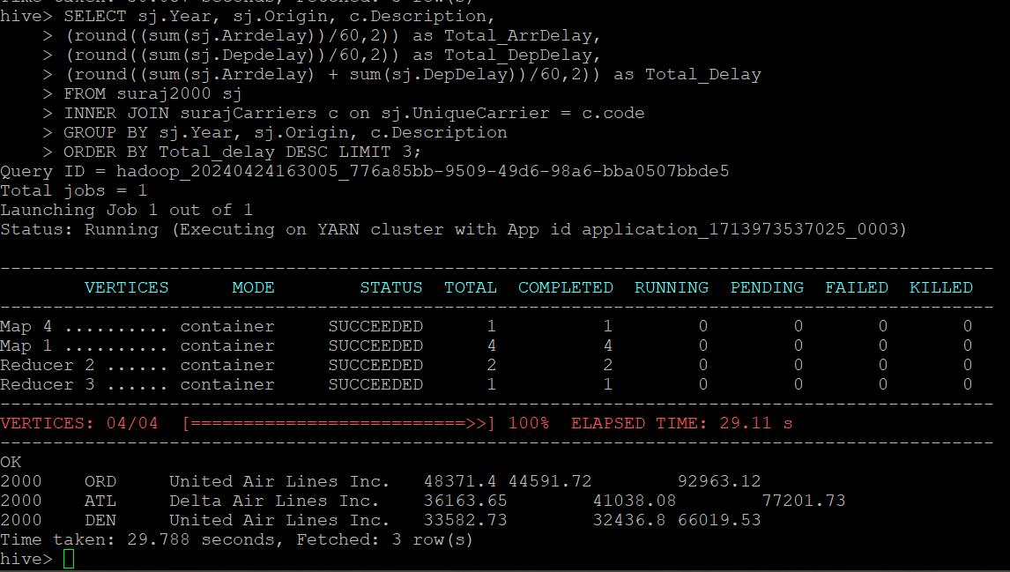
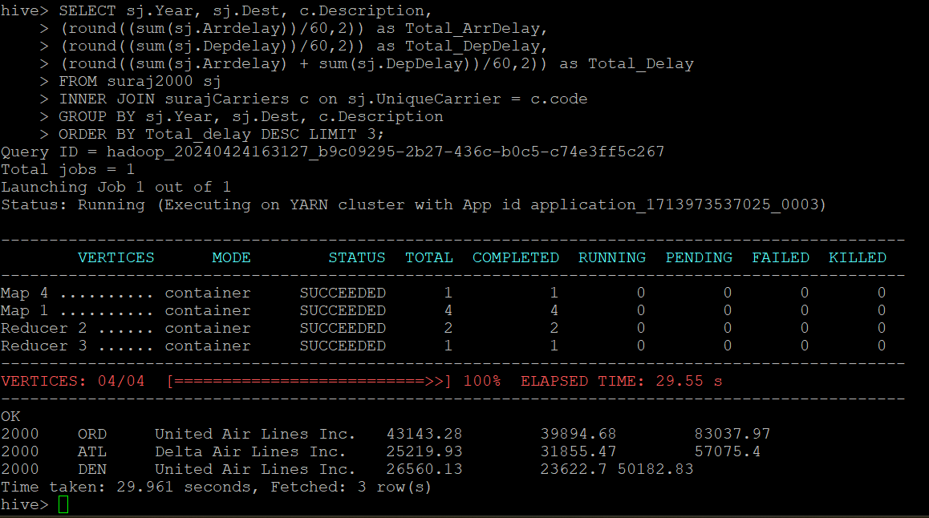
Step 4: Data Analysis
Determine the three Carriers with the highest delay time (in hours)
Year 1996
Origin
Dest
Step 4: Data Analysis
Determine the three Carriers with the highest delay time (in hours)
Year 2000
Origin
Dest
For Airports.csv
Wget https://dataverse.harvard.edu/api/access/datafile/:persistentId?persistentId=doi:10.7910/DVN/HG7NV7/XTPZZY
mv \:persistentId?persistentId=doi:10.7910%2FDVN%2FHG7NV7%2FXTPZZY Airports.csv
hdfs dfs -put Airports.csv /user/hive/warehouse - Copy the new file back to HDFS
head -n 10 Airports.csv -First 10 lines from csv file

Slide 24
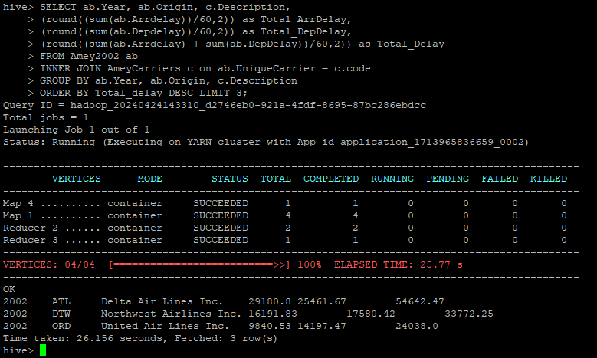
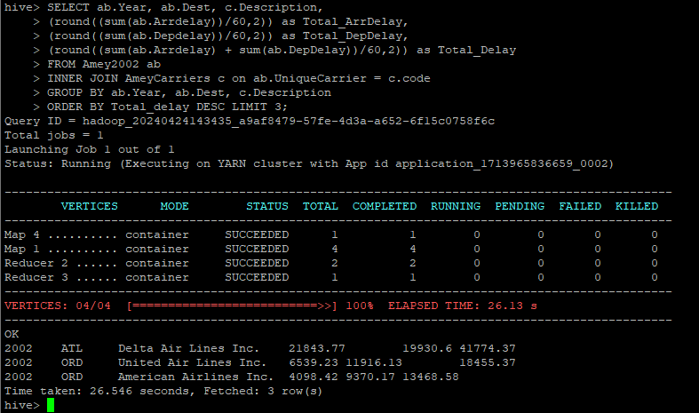
Step 4: Data Analysis
Determine the three Carriers with the highest delay time (in hours)
Year 2000
Origin
Dest
Step 4: Data Analysis
Determine the three Carriers with the highest delay time (in hours)
Year 2002
Origin
Dest
For Airports.csv
Wget https://dataverse.harvard.edu/api/access/datafile/:persistentId?persistentId=doi:10.7910/DVN/HG7NV7/XTPZZY
mv \:persistentId?persistentId=doi:10.7910%2FDVN%2FHG7NV7%2FXTPZZY Airports.csv
hdfs dfs -put Airports.csv /user/hive/warehouse - Copy the new file back to HDFS
head -n 10 Airports.csv -First 10 lines from csv file

Slide 25
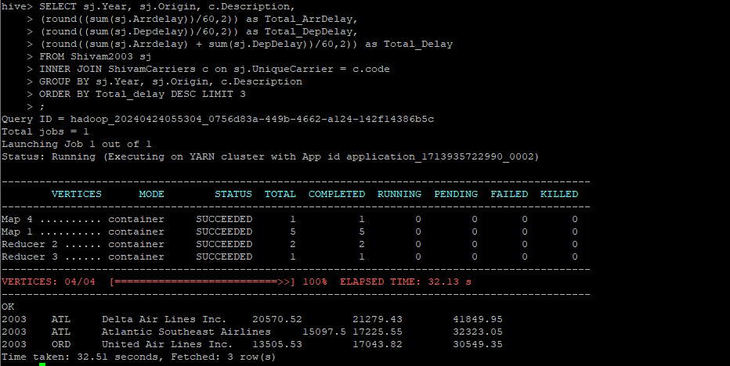
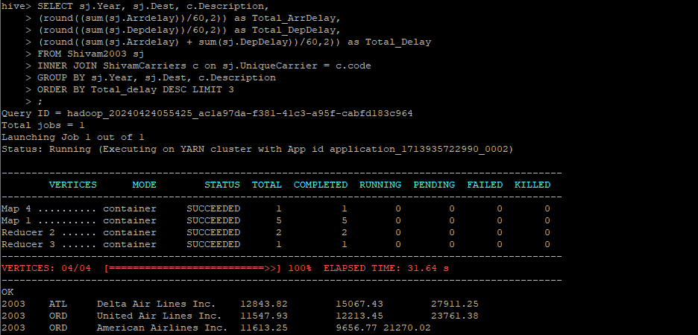
Step 4: Data Analysis
Determine the three Carriers with the highest delay time (in hours)
Year 2002
Origin
Dest
Step 4: Data Analysis
Determine the three Carriers with the highest delay time (in hours)
Year 2003
Origin
Dest
For Airports.csv
Wget https://dataverse.harvard.edu/api/access/datafile/:persistentId?persistentId=doi:10.7910/DVN/HG7NV7/XTPZZY
mv \:persistentId?persistentId=doi:10.7910%2FDVN%2FHG7NV7%2FXTPZZY Airports.csv
hdfs dfs -put Airports.csv /user/hive/warehouse - Copy the new file back to HDFS
head -n 10 Airports.csv -First 10 lines from csv file

Slide 26
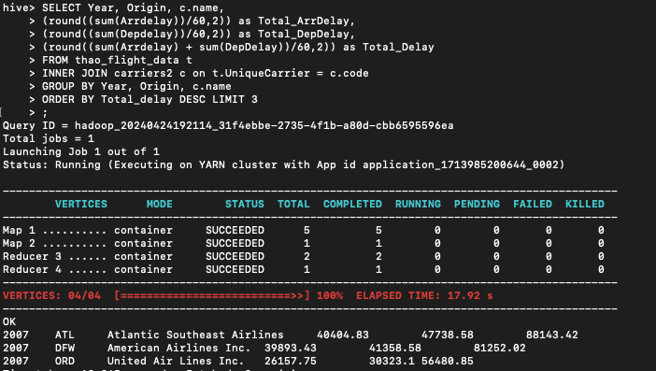
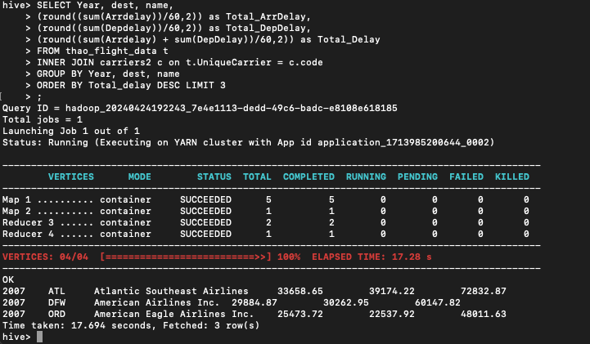
Step 4: Data Analysis
Determine the three Carriers with the highest delay time (in hours)
Year 2003
Origin
Dest
Step 4: Data Analysis
Determine the three Carriers with the highest delay time (in hours)
Year 2007
Origin
Dest
For Airports.csv
Wget https://dataverse.harvard.edu/api/access/datafile/:persistentId?persistentId=doi:10.7910/DVN/HG7NV7/XTPZZY
mv \:persistentId?persistentId=doi:10.7910%2FDVN%2FHG7NV7%2FXTPZZY Airports.csv
hdfs dfs -put Airports.csv /user/hive/warehouse - Copy the new file back to HDFS
head -n 10 Airports.csv -First 10 lines from csv file

Slide 27
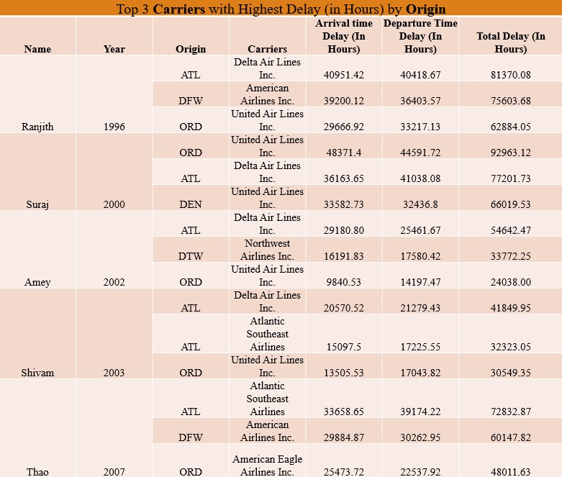
Step 4: Data Analysis
Determine the three Carriers with the highest delay time (in hours)
Year 2007
Origin
Dest
Step 4: Data Analysis
Determine the three Carriers with the highest delay time (in hours)
Table with results of all the Years together
Origin
For Airports.csv
Wget https://dataverse.harvard.edu/api/access/datafile/:persistentId?persistentId=doi:10.7910/DVN/HG7NV7/XTPZZY
mv \:persistentId?persistentId=doi:10.7910%2FDVN%2FHG7NV7%2FXTPZZY Airports.csv
hdfs dfs -put Airports.csv /user/hive/warehouse - Copy the new file back to HDFS
head -n 10 Airports.csv -First 10 lines from csv file

Slide 28
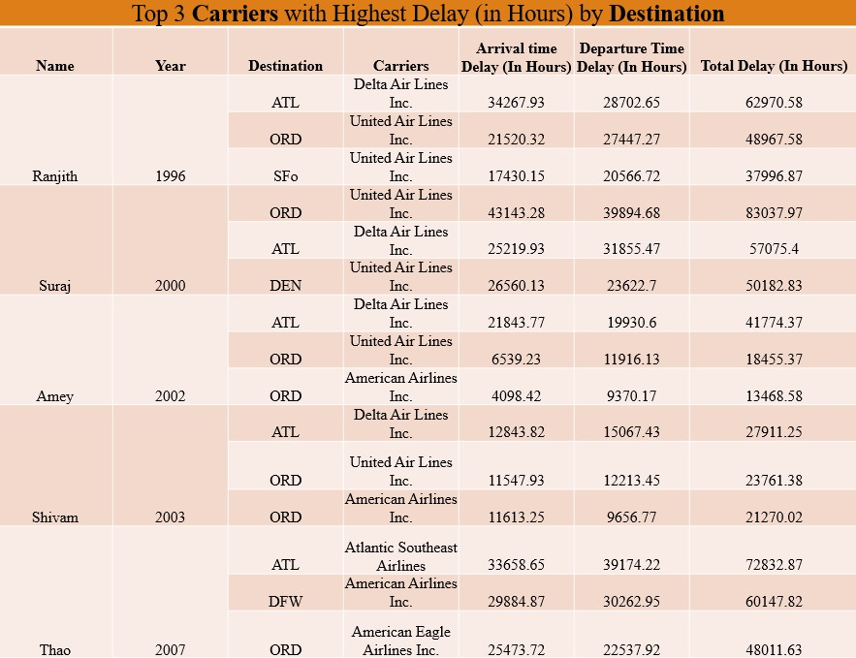
Step 4: Data Analysis
Determine the three Carriers with the highest delay time (in hours)
Table with results of all the Years together
Origin
Step 4: Data Analysis
Determine the three Carriers with the highest delay time (in hours)
Table with results of all the Years together
Dest
For Airports.csv
Wget https://dataverse.harvard.edu/api/access/datafile/:persistentId?persistentId=doi:10.7910/DVN/HG7NV7/XTPZZY
mv \:persistentId?persistentId=doi:10.7910%2FDVN%2FHG7NV7%2FXTPZZY Airports.csv
hdfs dfs -put Airports.csv /user/hive/warehouse - Copy the new file back to HDFS
head -n 10 Airports.csv -First 10 lines from csv file

Slide 29
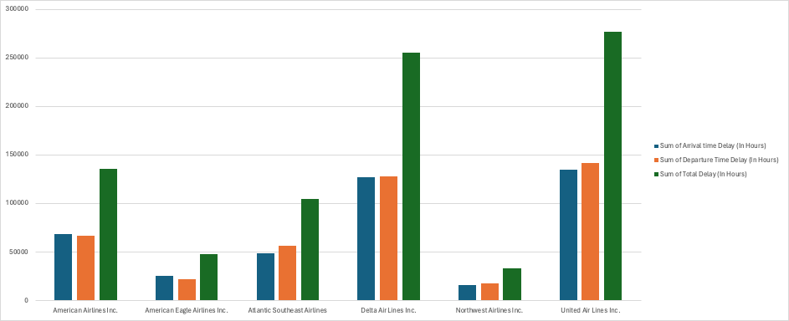
Step 4: Data Analysis
Determine the three Carriers with the highest delay time (in hours)
Table with results of all the Years together
Dest
Step 4: Data Analysis
Determine the three Carriers with the highest delay time (in hours)
Visulazation
Origin
For Airports.csv
Wget https://dataverse.harvard.edu/api/access/datafile/:persistentId?persistentId=doi:10.7910/DVN/HG7NV7/XTPZZY
mv \:persistentId?persistentId=doi:10.7910%2FDVN%2FHG7NV7%2FXTPZZY Airports.csv
hdfs dfs -put Airports.csv /user/hive/warehouse - Copy the new file back to HDFS
head -n 10 Airports.csv -First 10 lines from csv file

Slide 30
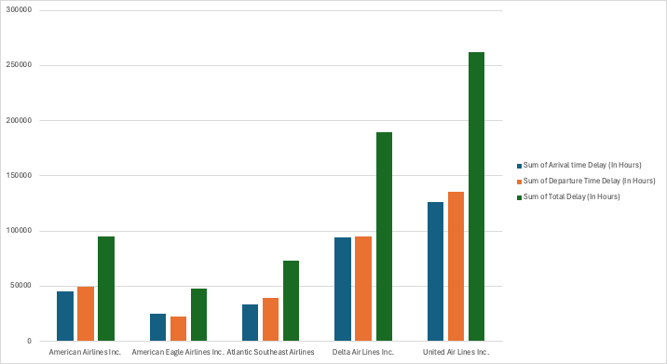
Step 4: Data Analysis
Determine the three Carriers with the highest delay time (in hours)
Visulazation
Origin
Step 4: Data Analysis
Determine the three Carriers with the highest delay time (in hours)
Visulazation
Dest
For Airports.csv
Wget https://dataverse.harvard.edu/api/access/datafile/:persistentId?persistentId=doi:10.7910/DVN/HG7NV7/XTPZZY
mv \:persistentId?persistentId=doi:10.7910%2FDVN%2FHG7NV7%2FXTPZZY Airports.csv
hdfs dfs -put Airports.csv /user/hive/warehouse - Copy the new file back to HDFS
head -n 10 Airports.csv -First 10 lines from csv file

Slide 31
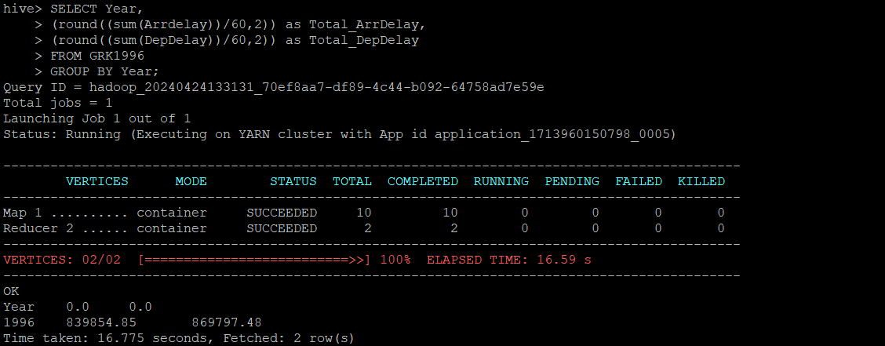
Step 4: Data Analysis
Determine the three Carriers with the highest delay time (in hours)
Visulazation
Dest
Step 4: Data Analysis
determine overall which type of delay (arrivals or departures) is the largest for your airports.
Year 1996
For Airports.csv
Wget https://dataverse.harvard.edu/api/access/datafile/:persistentId?persistentId=doi:10.7910/DVN/HG7NV7/XTPZZY
mv \:persistentId?persistentId=doi:10.7910%2FDVN%2FHG7NV7%2FXTPZZY Airports.csv
hdfs dfs -put Airports.csv /user/hive/warehouse - Copy the new file back to HDFS
head -n 10 Airports.csv -First 10 lines from csv file

Slide 32
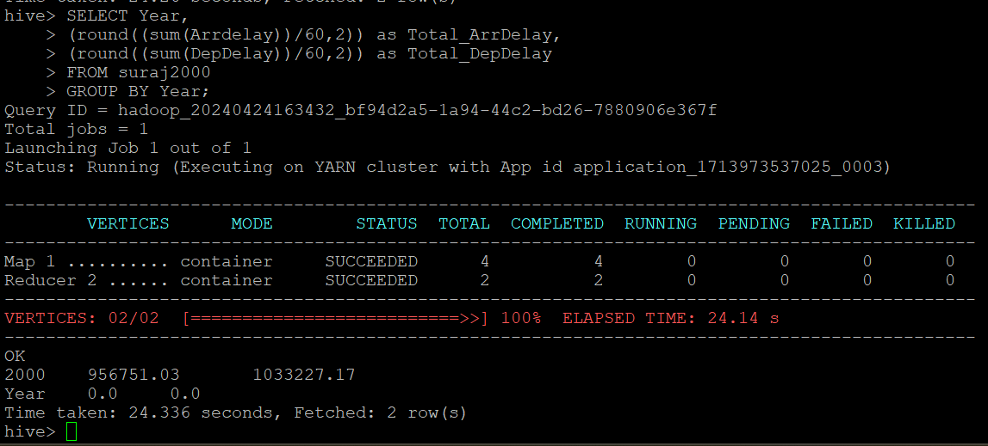
Step 4: Data Analysis
determine overall which type of delay (arrivals or departures) is the largest for your airports.
Year 1996
Step 4: Data Analysis
determine overall which type of delay (arrivals or departures) is the largest for your airports.
Year 2000
For Airports.csv
Wget https://dataverse.harvard.edu/api/access/datafile/:persistentId?persistentId=doi:10.7910/DVN/HG7NV7/XTPZZY
mv \:persistentId?persistentId=doi:10.7910%2FDVN%2FHG7NV7%2FXTPZZY Airports.csv
hdfs dfs -put Airports.csv /user/hive/warehouse - Copy the new file back to HDFS
head -n 10 Airports.csv -First 10 lines from csv file

Slide 33
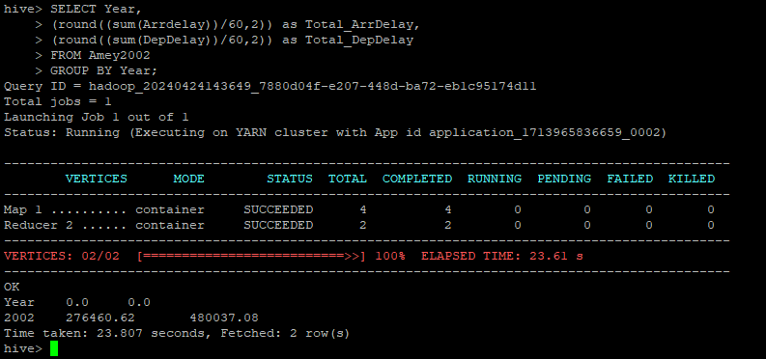
Step 4: Data Analysis
determine overall which type of delay (arrivals or departures) is the largest for your airports.
Year 2000
Step 4: Data Analysis
determine overall which type of delay (arrivals or departures) is the largest for your airports.
Year 2002
For Airports.csv
Wget https://dataverse.harvard.edu/api/access/datafile/:persistentId?persistentId=doi:10.7910/DVN/HG7NV7/XTPZZY
mv \:persistentId?persistentId=doi:10.7910%2FDVN%2FHG7NV7%2FXTPZZY Airports.csv
hdfs dfs -put Airports.csv /user/hive/warehouse - Copy the new file back to HDFS
head -n 10 Airports.csv -First 10 lines from csv file

Slide 34
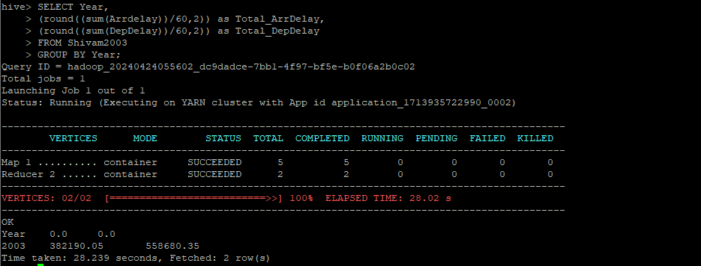
Step 4: Data Analysis
determine overall which type of delay (arrivals or departures) is the largest for your airports.
Year 2002
Step 4: Data Analysis
determine overall which type of delay (arrivals or departures) is the largest for your airports.
Year 2003
For Airports.csv
Wget https://dataverse.harvard.edu/api/access/datafile/:persistentId?persistentId=doi:10.7910/DVN/HG7NV7/XTPZZY
mv \:persistentId?persistentId=doi:10.7910%2FDVN%2FHG7NV7%2FXTPZZY Airports.csv
hdfs dfs -put Airports.csv /user/hive/warehouse - Copy the new file back to HDFS
head -n 10 Airports.csv -First 10 lines from csv file

Slide 35
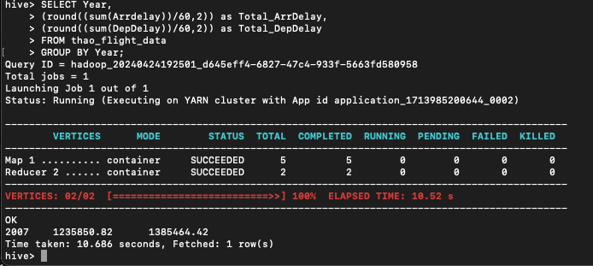
Step 4: Data Analysis
determine overall which type of delay (arrivals or departures) is the largest for your airports.
Year 2003
Step 4: Data Analysis
determine overall which type of delay (arrivals or departures) is the largest for your airports.
Year 2007
For Airports.csv
Wget https://dataverse.harvard.edu/api/access/datafile/:persistentId?persistentId=doi:10.7910/DVN/HG7NV7/XTPZZY
mv \:persistentId?persistentId=doi:10.7910%2FDVN%2FHG7NV7%2FXTPZZY Airports.csv
hdfs dfs -put Airports.csv /user/hive/warehouse - Copy the new file back to HDFS
head -n 10 Airports.csv -First 10 lines from csv file

Slide 36
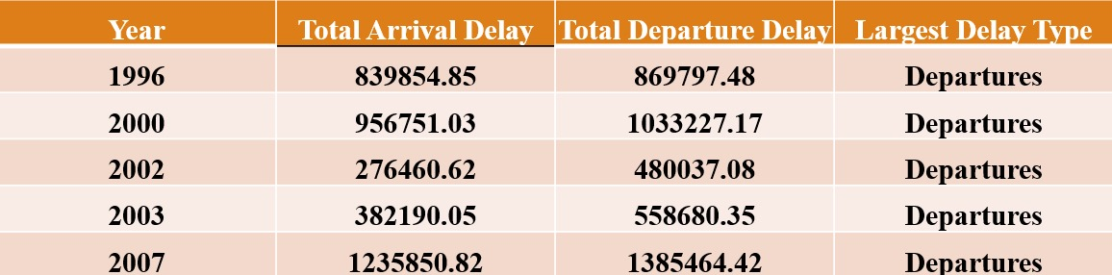
Step 4: Data Analysis
determine overall which type of delay (arrivals or departures) is the largest for your airports.
Year 2007
Step 4: Data Analysis
determine overall which type of delay (arrivals or departures) is the largest for your airports.
Table with results of all the Years together
For Airports.csv
Wget https://dataverse.harvard.edu/api/access/datafile/:persistentId?persistentId=doi:10.7910/DVN/HG7NV7/XTPZZY
mv \:persistentId?persistentId=doi:10.7910%2FDVN%2FHG7NV7%2FXTPZZY Airports.csv
hdfs dfs -put Airports.csv /user/hive/warehouse - Copy the new file back to HDFS
head -n 10 Airports.csv -First 10 lines from csv file

Slide 37
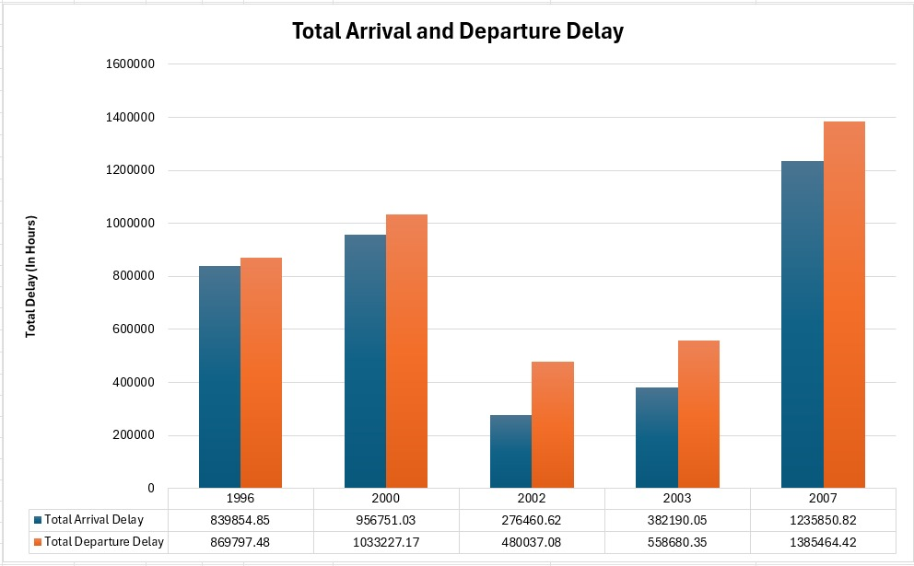
Step 4: Data Analysis
determine overall which type of delay (arrivals or departures) is the largest for your airports.
Table with results of all the Years together
Step 4: Data Analysis
determine overall which type of delay (arrivals or departures) is the largest for your airports.
Visualization
For Airports.csv
Wget https://dataverse.harvard.edu/api/access/datafile/:persistentId?persistentId=doi:10.7910/DVN/HG7NV7/XTPZZY
mv \:persistentId?persistentId=doi:10.7910%2FDVN%2FHG7NV7%2FXTPZZY Airports.csv
hdfs dfs -put Airports.csv /user/hive/warehouse - Copy the new file back to HDFS
head -n 10 Airports.csv -First 10 lines from csv file

Slide 38
Step 4: Data Analysis
determine overall which type of delay (arrivals or departures) is the largest for your airports.
Visualization
THANK YOU !
For Airports.csv
Wget https://dataverse.harvard.edu/api/access/datafile/:persistentId?persistentId=doi:10.7910/DVN/HG7NV7/XTPZZY
mv \:persistentId?persistentId=doi:10.7910%2FDVN%2FHG7NV7%2FXTPZZY Airports.csv
hdfs dfs -put Airports.csv /user/hive/warehouse - Copy the new file back to HDFS
head -n 10 Airports.csv -First 10 lines from csv file

Slide 39
Step 4: Data Analysis
determine overall which type of delay (arrivals or departures) is the largest for your airports.
Visualization
For Airports.csv
Wget https://dataverse.harvard.edu/api/access/datafile/:persistentId?persistentId=doi:10.7910/DVN/HG7NV7/XTPZZY
mv \:persistentId?persistentId=doi:10.7910%2FDVN%2FHG7NV7%2FXTPZZY Airports.csv
hdfs dfs -put Airports.csv /user/hive/warehouse - Copy the new file back to HDFS
head -n 10 Airports.csv -First 10 lines from csv file
THANK YOU !

